Slide 1
Cellular Wireless Networks
Chapter 10

Slide 2
Cellular Network Organization
Use multiple low-power transmitters (100 W or less)
Areas divided into cells
  Each served by its own antenna
  Served by base station consisting of transmitter, receiver, and control unit
  Band of frequencies allocated
  Cells set up such that antennas of all neighbors are equidistant (hexagonal pattern)

Slide 3
Frequency Reuse
Adjacent cells assigned different frequencies to avoid interference or crosstalk
Objective is to reuse frequency in nearby cells
  10 to 50 frequencies assigned to each cell
  Transmission power controlled to limit power at that frequency escaping to adjacent cells
  The issue is to determine how many cells must intervene between two cells using the same frequency

Slide 4
Approaches to Cope with Increasing Capacity
Adding new channels
Frequency borrowing – frequencies are taken from adjacent cells by congested cells
Cell splitting – cells in areas of high usage can be split into smaller cells
Cell sectoring – cells are divided into a number of wedge-shaped sectors, each with their own set of channels
Microcells – antennas move to buildings, hills, and lamp posts

Slide 5
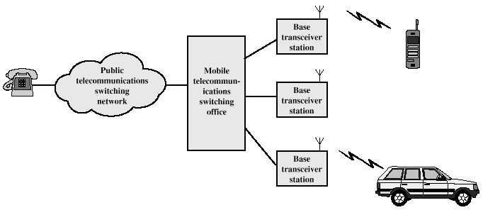
Cellular System Overview

Slide 6
Cellular Systems Terms
Base Station (BS) – includes an antenna, a controller, and a number of receivers
Mobile telecommunications switching office (MTSO) – connects calls between mobile units
Two types of channels available between mobile unit and BS
  Control channels – used to exchange information having to do with setting up and maintaining calls
  Traffic channels – carry voice or data connection between users

Slide 7
Steps in an MTSO Controlled Call between Mobile Users
Mobile unit initialization
Mobile-originated call
Paging
Call accepted
Ongoing call
Handoff

Slide 8
Additional Functions in an MTSO Controlled Call
Call blocking
Call termination
Call drop
Calls to/from fixed and remote mobile subscriber

Slide 9
Mobile Radio Propagation Effects
Signal strength
  Must be strong enough between base station and mobile unit to maintain signal quality at the receiver
  Must not be so strong as to create too much cochannel interference with channels in another cell using the same frequency band
Fading
  Signal propagation effects may disrupt the signal and cause errors

Slide 10
Handoff Performance Metrics
Cell blocking probability – probability of a new call being blocked
Call dropping probability – probability that a call is terminated due to a handoff
Call completion probability – probability that an admitted call is not dropped before it terminates
Probability of unsuccessful handoff – probability that a handoff is executed while the reception conditions are inadequate

Slide 11
Handoff Performance Metrics
Handoff blocking probability – probability that a handoff cannot be successfully completed
Handoff probability – probability that a handoff occurs before call termination
Rate of handoff – number of handoffs per unit time
Interruption duration – duration of time during a handoff in which a mobile is not connected to either base station
Handoff delay – distance the mobile moves from the point at which the handoff should occur to the point at which it does occur

Slide 12
First-Generation Analog
Advanced Mobile Phone Service (AMPS)
  In North America, two 25-MHz bands allocated to AMPS
    One for transmission from base to mobile unit
    One for transmission from mobile unit to base
  Each band split in two to encourage competition
  Frequency reuse exploited

Slide 13
Differences Between First and Second Generation Systems
Digital traffic channels – first-generation systems are almost purely analog; second-generation systems are digital
Encryption – all second generation systems provide encryption to prevent eavesdropping
Error detection and correction – second-generation digital traffic allows for detection and correction, giving clear voice reception
Channel access – second-generation systems allow channels to be dynamically shared by a number of users

Slide 14
Mobile Station
Mobile station communicates across Um interface (air interface) with base station transceiver in same cell as mobile unit
Mobile equipment (ME) – physical terminal, such as a telephone or PCS
  ME includes radio transceiver, digital signal processors and subscriber identity module (SIM)
GSM subscriber units are generic until SIM is inserted
  SIMs roam, not necessarily the subscriber devices

Slide 15
Base Station Subsystem (BSS)
BSS consists of base station controller and one or more base transceiver stations (BTS)
Each BTS defines a single cell
  Includes radio antenna, radio transceiver and a link to a base station controller (BSC)
BSC reserves radio frequencies, manages handoff of mobile unit from one cell to another within BSS, and controls paging

Slide 16
Network Subsystem (NS)
NS provides link between cellular network and public switched telecommunications networks
  Controls handoffs between cells in different BSSs
  Authenticates users and validates accounts
  Enables worldwide roaming of mobile users
Central element of NS is the mobile switching center (MSC)

Slide 17
Mobile Switching Center (MSC) Databases
Home location register (HLR) database – stores information about each subscriber that belongs to it
Visitor location register (VLR) database – maintains information about subscribers currently physically in the region
Authentication center database (AuC) – used for authentication activities, holds encryption keys
Equipment identity register database (EIR) – keeps track of the type of equipment that exists at the mobile station

